Slide 1
Training a Conv Net to Focus the Microscope
Summer 2019 Rotation Project

Slide 2
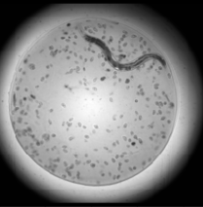
Problem
Want to image worms in divots
44 possible focal planes, which will provide the best image?
Current focus algorithm gets hung up on artifact, does not reliably choose a usable focus

Slide 3
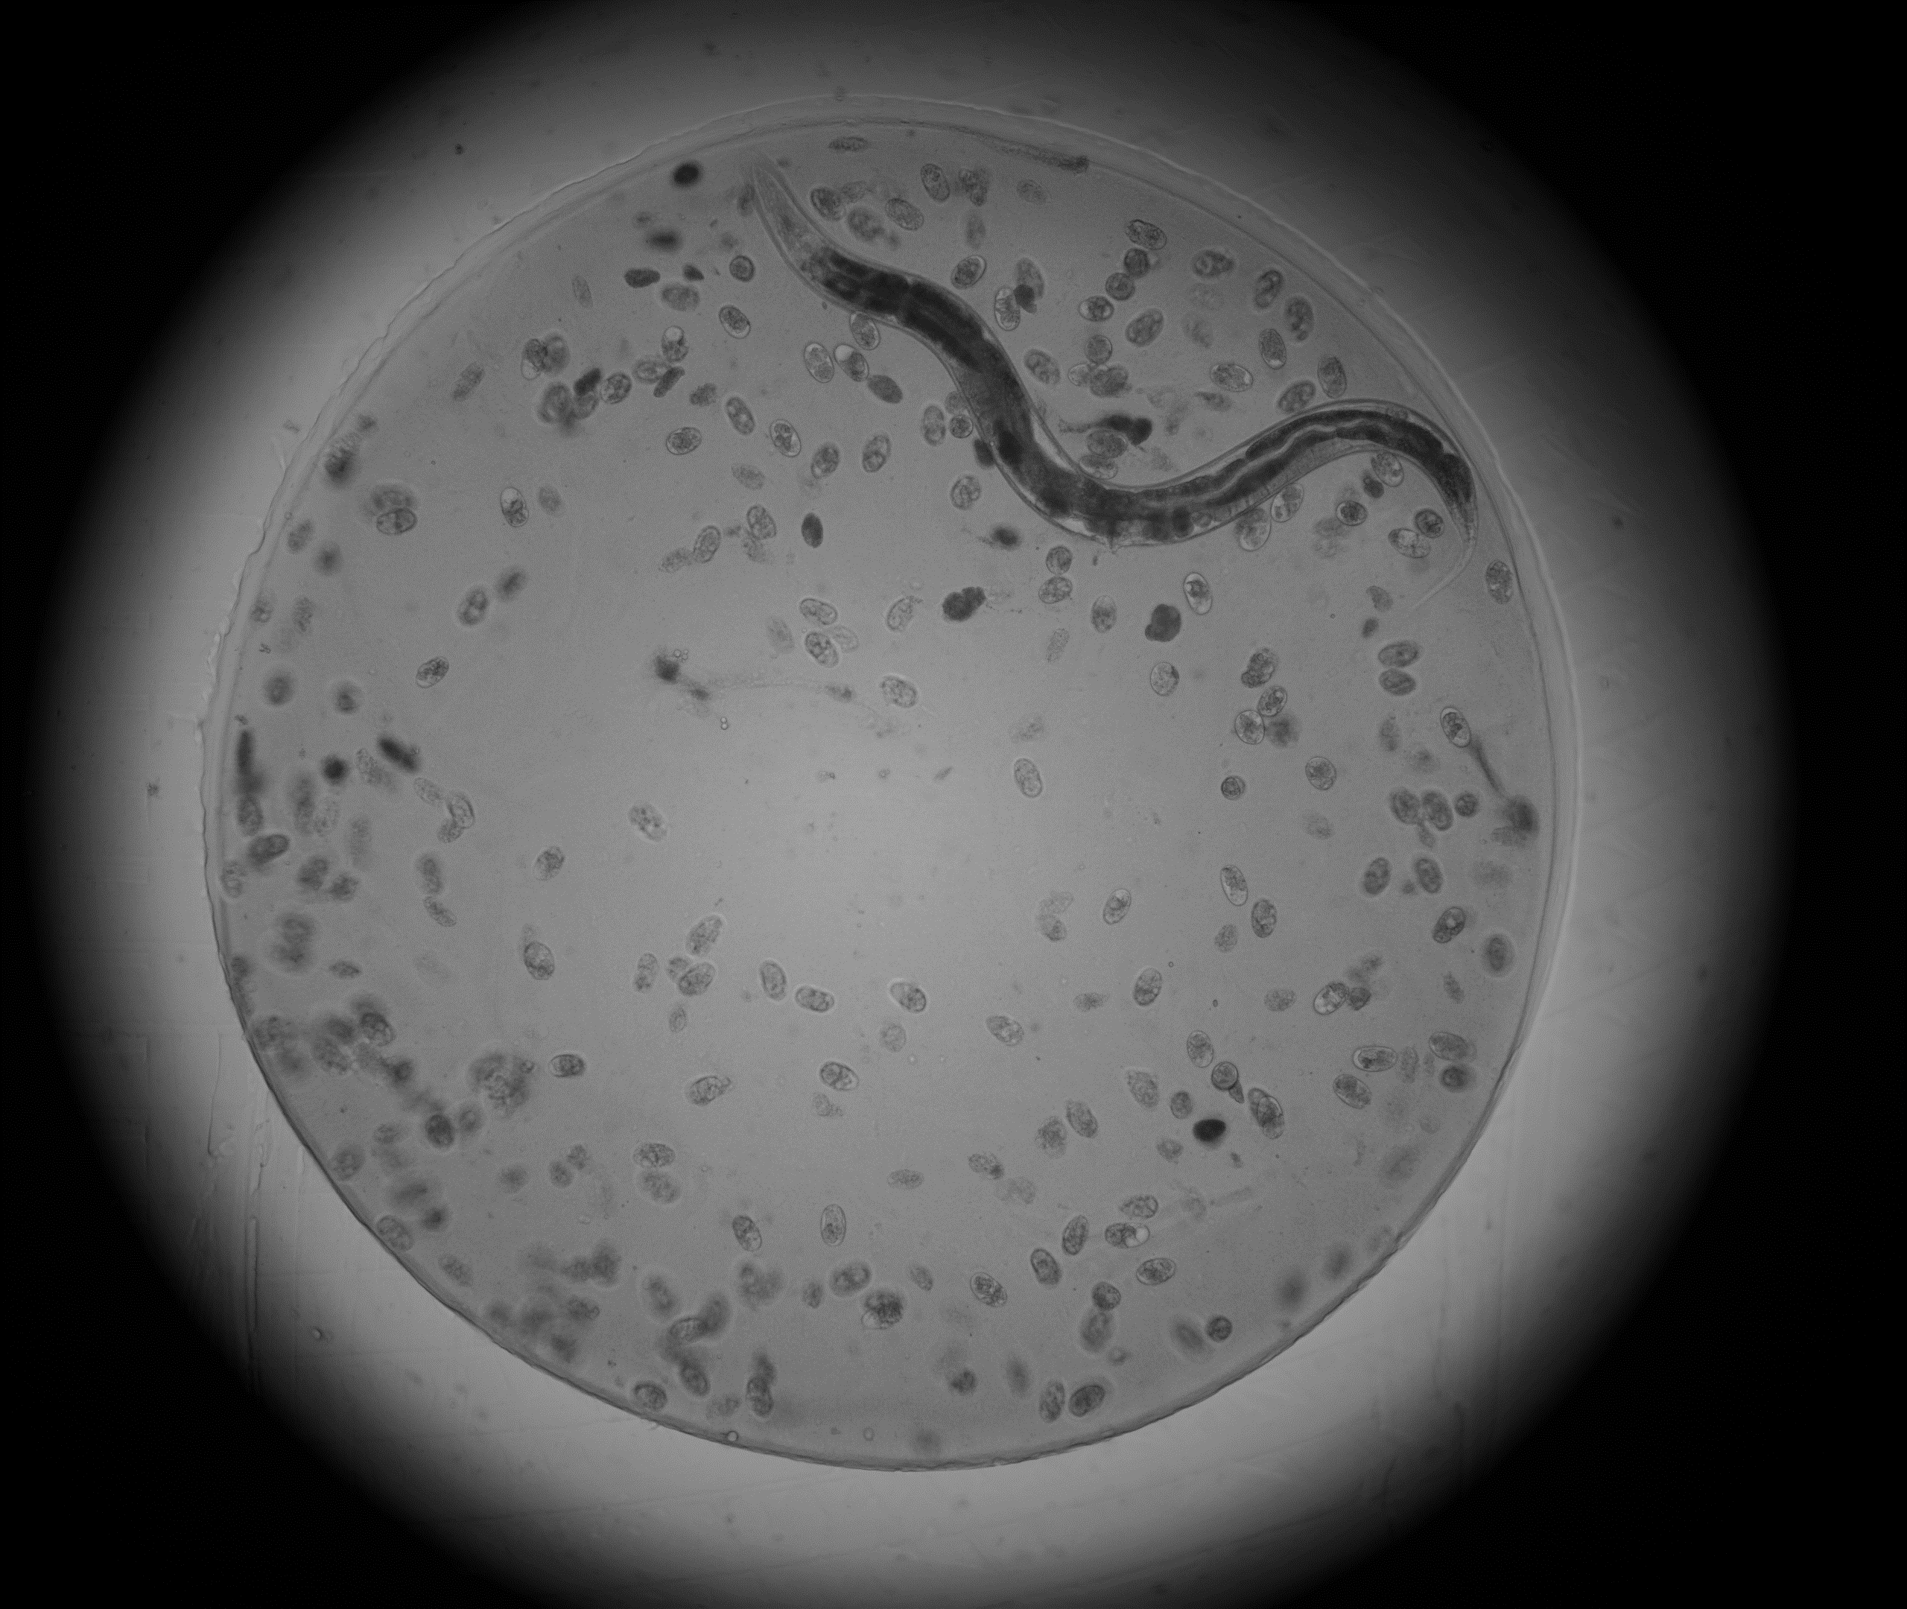
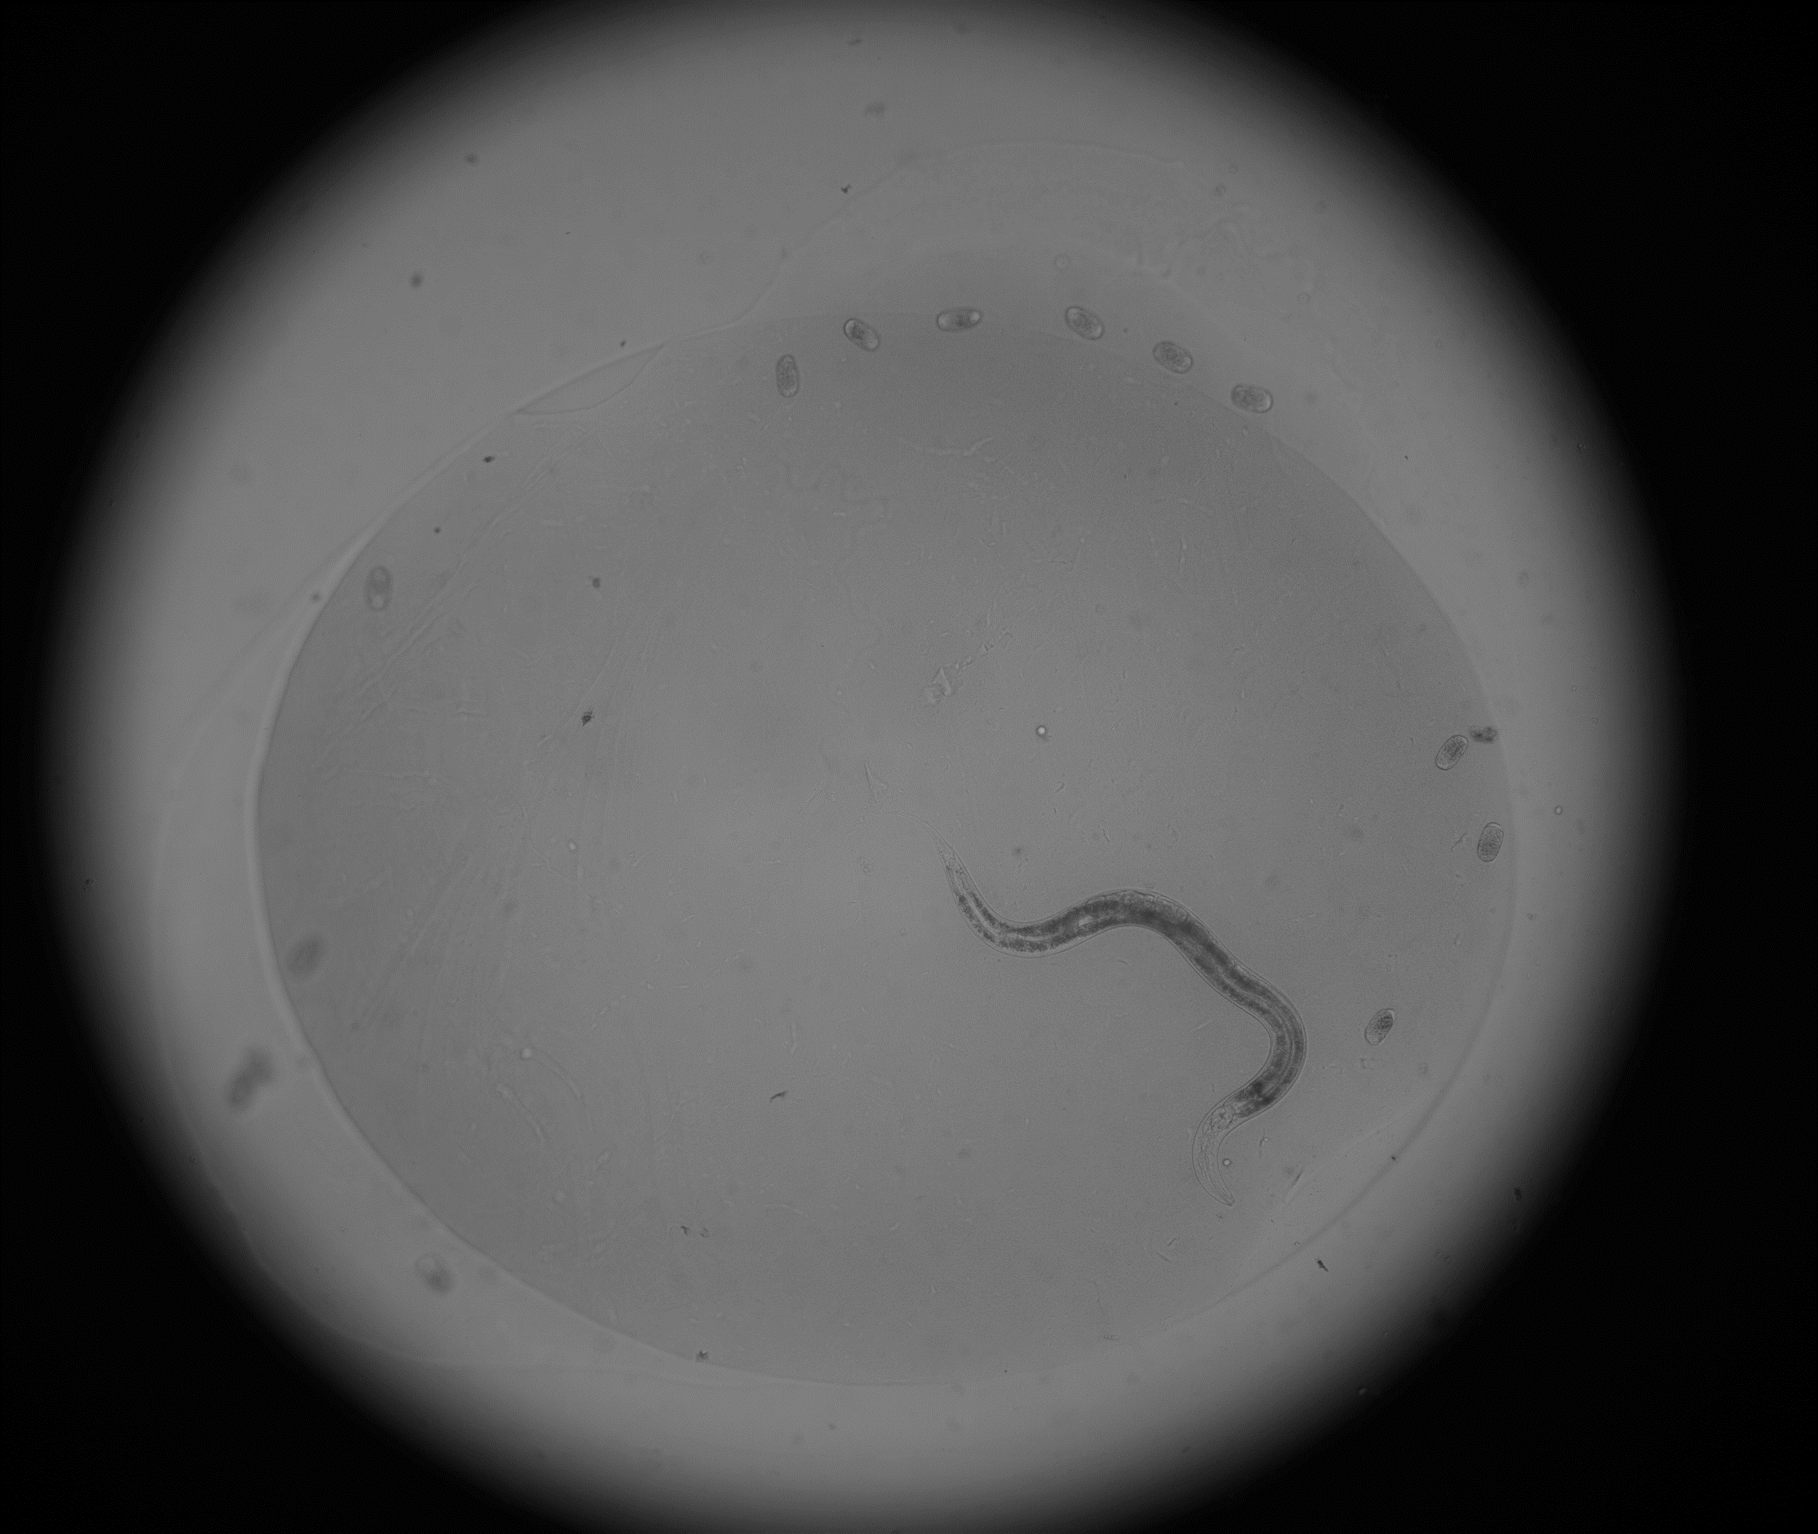
Problem
In focus
Out of focus
Which direction, above or below?
How many focal planes to move?

Slide 4
Idea
Train a convolutional neural network to detect good vs. bad focus and tell the microscope how many focus planes to move to correct it
Convolutional neural net well suited for image classification
Can use a pre-trained network, a pre-defined network trained from scratch, or build and train a new network
Pre-trained networks are feature detectors – detect edges, curves, etc. Need a much smaller amount of training to learn how to classify based on the features they are already trained to recognize
Based on organization of the visual system

Slide 5
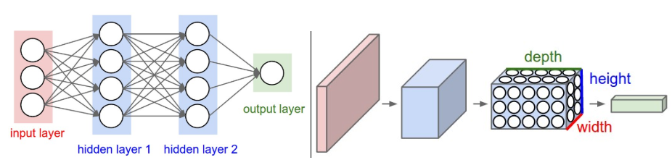
Conv Net Overview
Regular Neural Net
Convolutional Neural Net
Image from Stanford CS231 (http://cs231n.github.io/convolutional-networks/)
In a classification problem, output is a vector of probabilities corresponding to the classes
Each of the layers in the regular net is fully connected, this causes rapid increase in the number of weights
Notes:
This is a 3 slide intro to conv nets – of course it is not comprehensive
Will the student be admitted to WashU? GPA, test scores, essay, extracurricular stuff. Figure out weight to give to each, then generate a prediction.

Slide 6
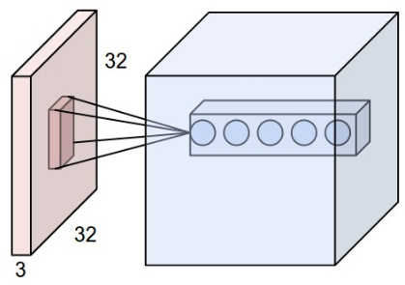
Conv Net Overview
Each “neuron” is only connected to a small part of the preceding layer
Depth corresponds to feature detectors
Major simplifying assumption is that if something matters in one part of the input, it matters in the rest so gradient can be convolved over the entire section
Why these are “convolutional” as opposed to regular neural networks
Image from Stanford CS231 (http://cs231n.github.io/convolutional-networks/)

Slide 7
Conv Net Overview - Training
Input is given to the conv net, it uses random or pretrained weights to generate an output
Output is compared to ground truth, loss function converts this into a value which can be minimized
In backpropagation, a gradient is calculated for each layer – combined to get a gradient for the full network
Using the gradient, the weights which will minimize loss (prediction errors) can be determined
The current weights in the network are updated towards the weights that minimize loss, how much is determined by optimizer
Repeat
Loss as a function of weight
Gradient
Value of weight

Slide 8
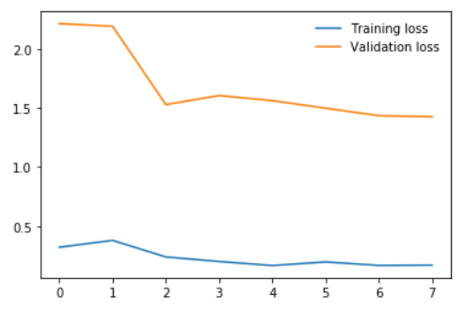
Overfitting
The steps on the previous slide are performed with training data
After a round of training, performance of the model should be checked on test data that was not used for training to ensure the model is learning to recognize features and not just learning the order of images or something
In this plot from training, the model performs better on the training data than the test data, which is normal
The validation (test) loss improves with rounds of training, which indicates the model is learning to recognize generalizeable features

Slide 9

Pytorch
Developed specifically for working with conv nets, lots of the functionality needed is built right in
Tensors keep track of operations for easy backpropogation
Dataset and Dataloader classes for import
Built in library of pre-trained conv nets

Slide 10
Making a Labelled Training Set
Code to find image stacks in an experiment folder
Opens up a flipbook of the stack RisWidget
Button in RisWidget will create a text file in the stack with the number of the best focus image
Also has an option for “no worm” so the stack will be excluded from training
22
Best
Best.txt

Slide 11

Sort Images for PyTorch Import
> 6 planes above best focus
5
1 to 6 planes above best focus
PyTorch detects which class an image belongs to based on the folder it is stored in
Sorter code finds image stacks, detects if there is a best.txt file, then copies the image into a folder based on how far from the best focus the image is
3 category: above, good, below
5 category: very out of focus above, slightly out above, good, slightly out below, very out below
3
Within 1 focal plane of best focus
2
Focus stack of images
1 to 6 planes below best focus
1
> 6 planes below best focus
0

Slide 12
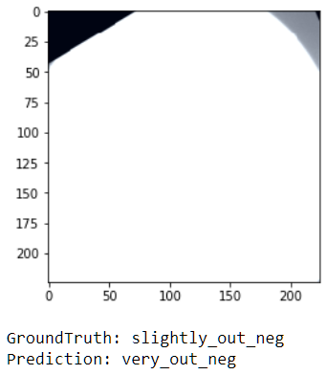
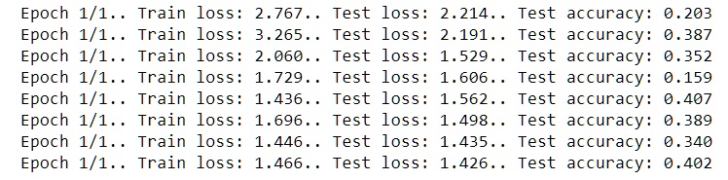
Initial Training
Trained Resnet50 using code mostly from tutorial
Training started to plateau around 40% accuracy
Took a look at the training images after import with Pytorch ImageFolder dataset
Notes:
Left to it’s own devices Pytorch is REALLY BAD at importing our greyscale images

Slide 13
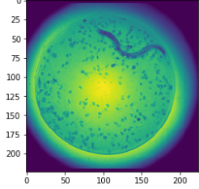
Import Images into Pytorch
Created custom code to do this – pre-made networks such as Resnet expect 224 by 224 (or smaller) RGB images
Shrink the image, then stack 3x
Substantial loss of resolution
Still much better than ImageFolder
Future direction: build a model from scratch that will take 1D black and white images so less information is lost in this step

Slide 14
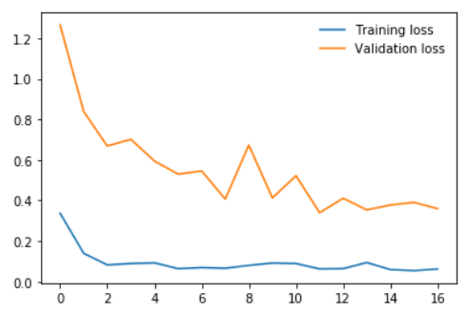
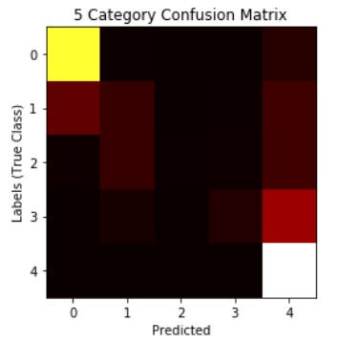
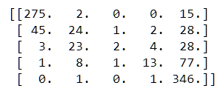
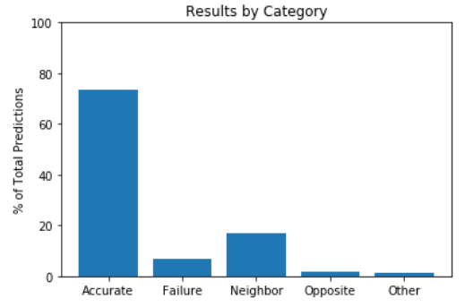
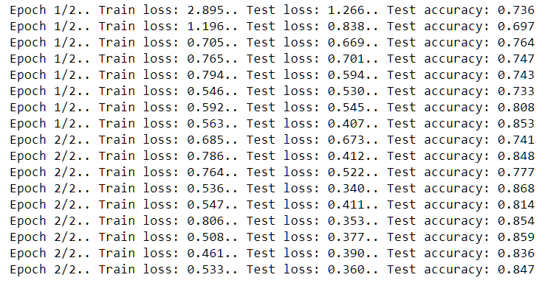
Training with Better Images – 5 Categories
True Class
Predicted

Slide 15
Applying the Model – Funnel Algorithm
Above
Get a prediction to determine above/below and general distance
Update the upper or lower bound
Move to a new focus plane ~2/3 of the distance from the current position to the opposite bound
Modify how far to move based on very vs. slightly out of focus
# of Focal Planes from Best
Best Focus
Below

Slide 16
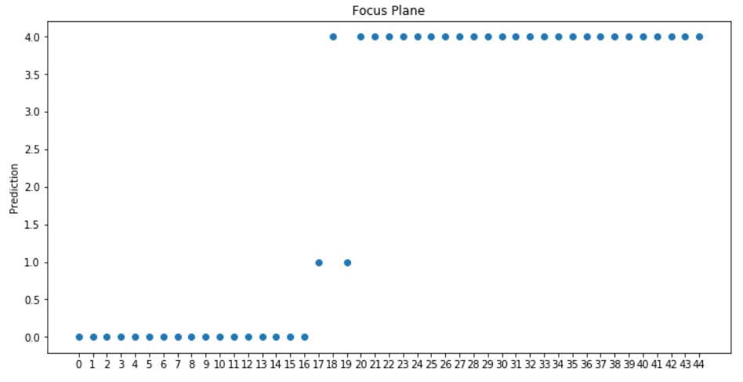
Applying the Model – Full Stack Algorithm
Very out positive
Go through each image in the stack, generate a prediction
Select the median of all images predicted to be in-focus as the best focus
Slightly out positive
In focus
Slightly out negative
Very out negative

Slide 17
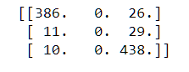
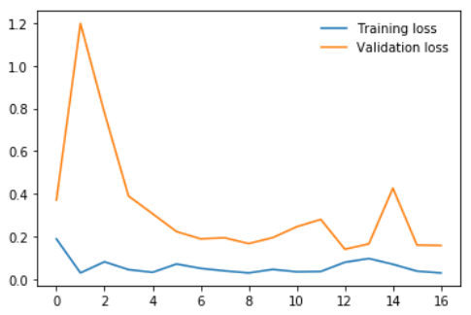
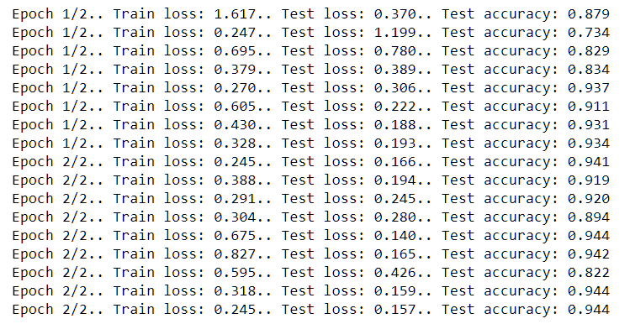
Training with 3 Categories
Confusion Matrix for 3 Cat
True
Predicted
Accuracy exceeded 90% by the 5th round of training
HOWEVER
In a stack of 44 images, only 3 are considered good focus. This network learned that it’s a poor bet to classify anything as good focus.

Slide 18
Reconsider 5 Category…….
True
Predicted

Slide 19
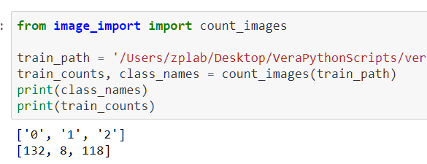
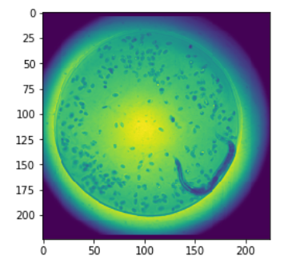
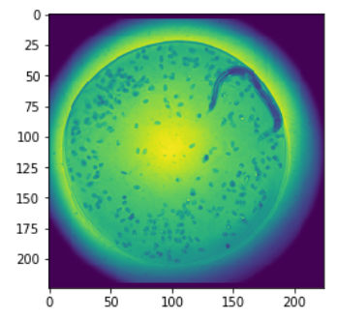
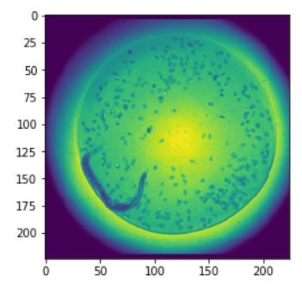
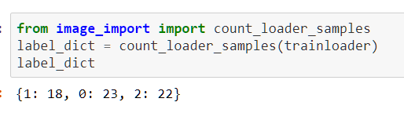
Correcting for Bias and Data Augmentation
Augment and Bias Correct

Slide 20
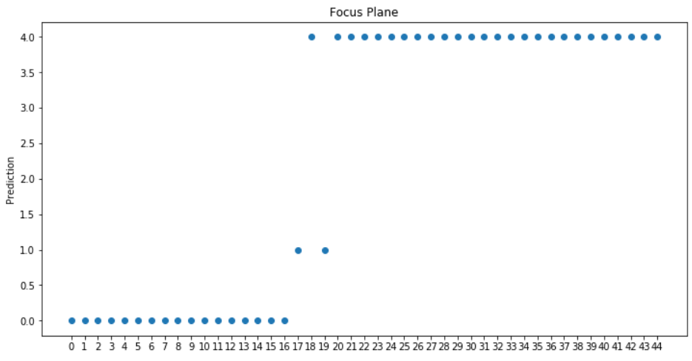
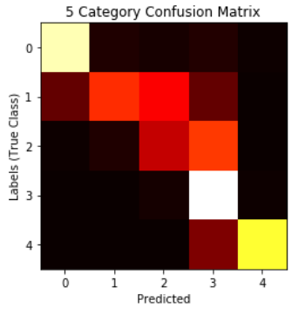
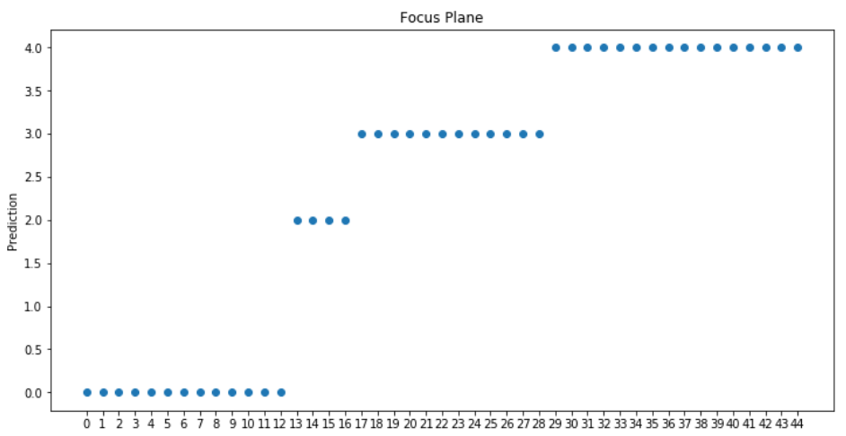
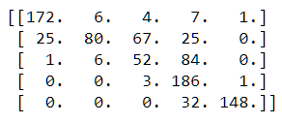
Before
After

Slide 21
Future Directions
More training with bias correction to get better identification of in-focus images
Identify source of the bias towards above focus errors
Build and train a model from scratch that will accept greyscale images
Modify a pre-made model to accept greyscale and train from scratch

Slide 22
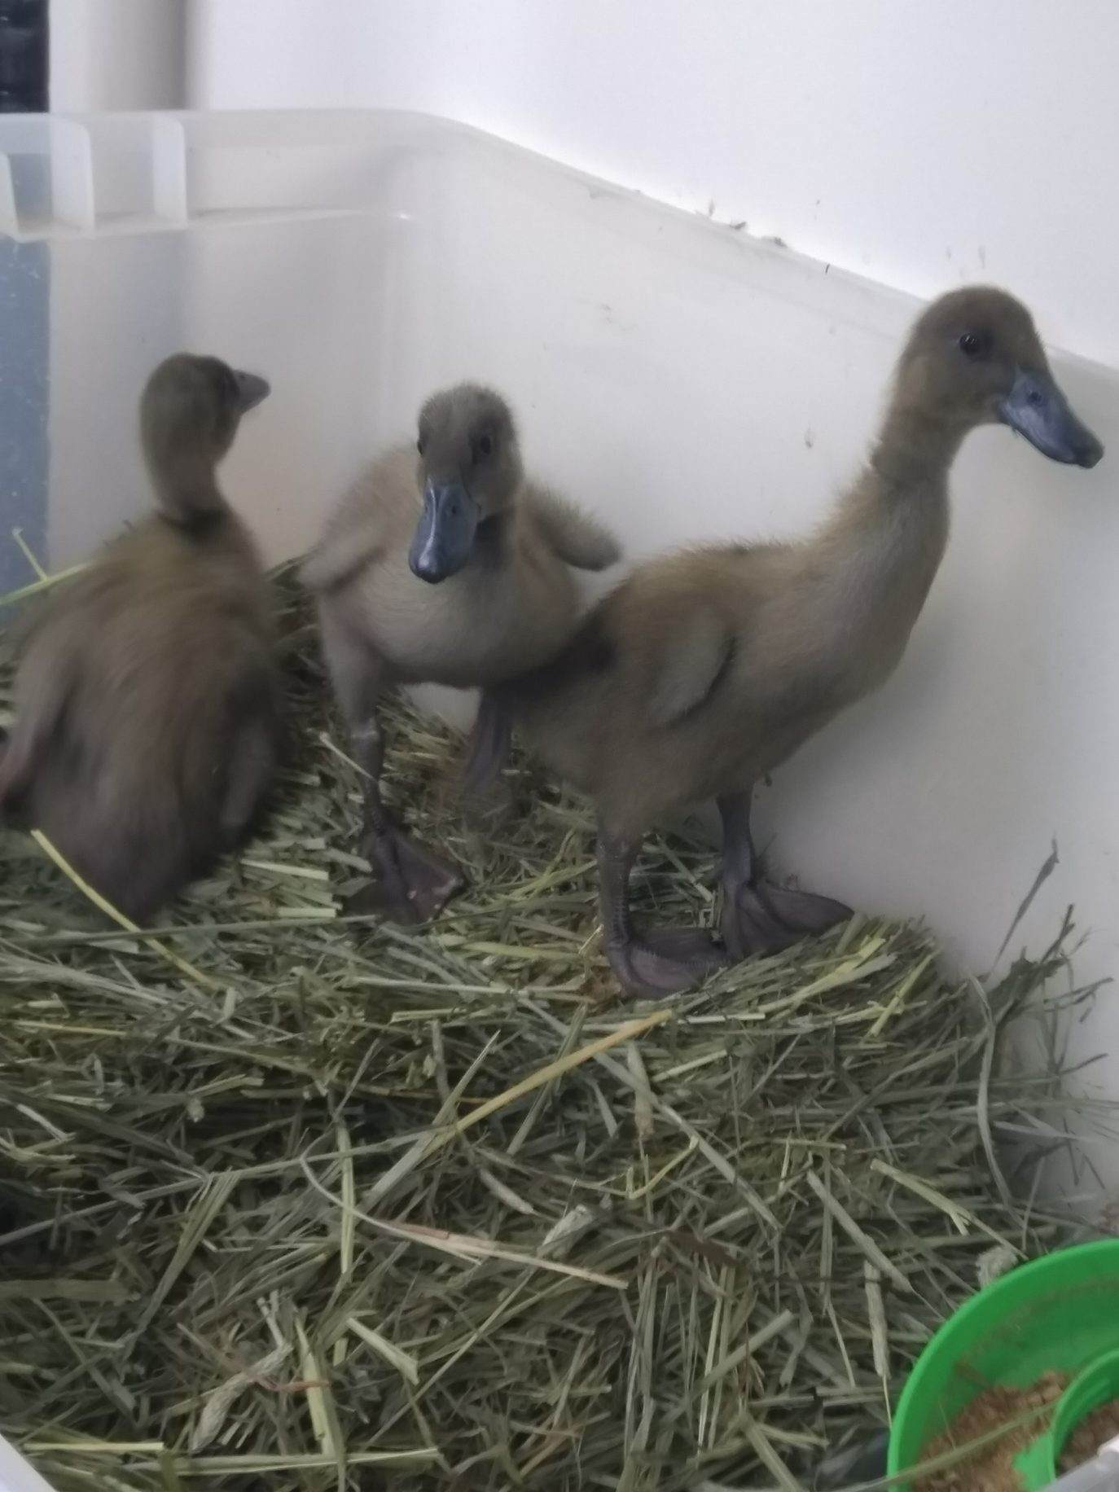
Any Additional Questions?

